Slide 1


Rescuing penguins with Rust
By Julien Faixo – May 2022
Notes:
Introduction du sujet

Slide 2
Agenda
What really impacts power consumption ?
Let’s talk about technology footprints
What can we do for the penguins ?
Rust to the rescue !
Rescuing penguins with Rust – Julien Faixo

Slide 3


Who am I
Julien Faixo
@jfaixo
Tech enthusiast and passionate 🤟
Rust lover 🦀 Monkey Island fan 🏴‍☠️
Software architect & dev @ Sopra Steria 10+ years…
Rescuing penguins with Rust – Julien Faixo

Slide 4

What really impacts power consumption ?

Slide 5
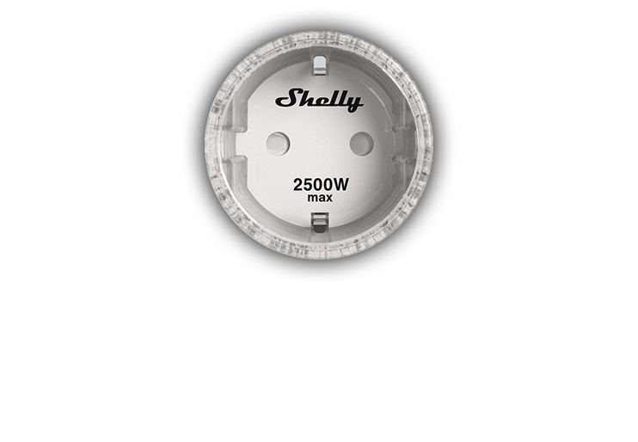
Let me introduce you to Shelly
Shelly Plug S
Wifi operated plug
Standalone
Power measurement
HTTP & MQTT APIs
Rescuing penguins with Rust – Julien Faixo
Notes:
Standalone: lots of nice features (scheduling, power throttling, small web server, integrations, cloud...)

Slide 6
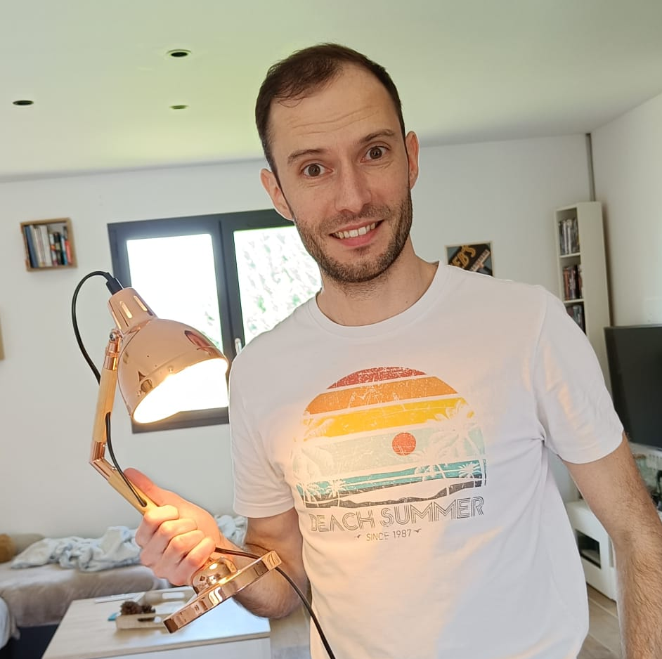
A light bulb 💡
Theoretical input power
2 W
Shelly said: "2.06 W"
Rescuing penguins with Rust – Julien Faixo

Slide 7
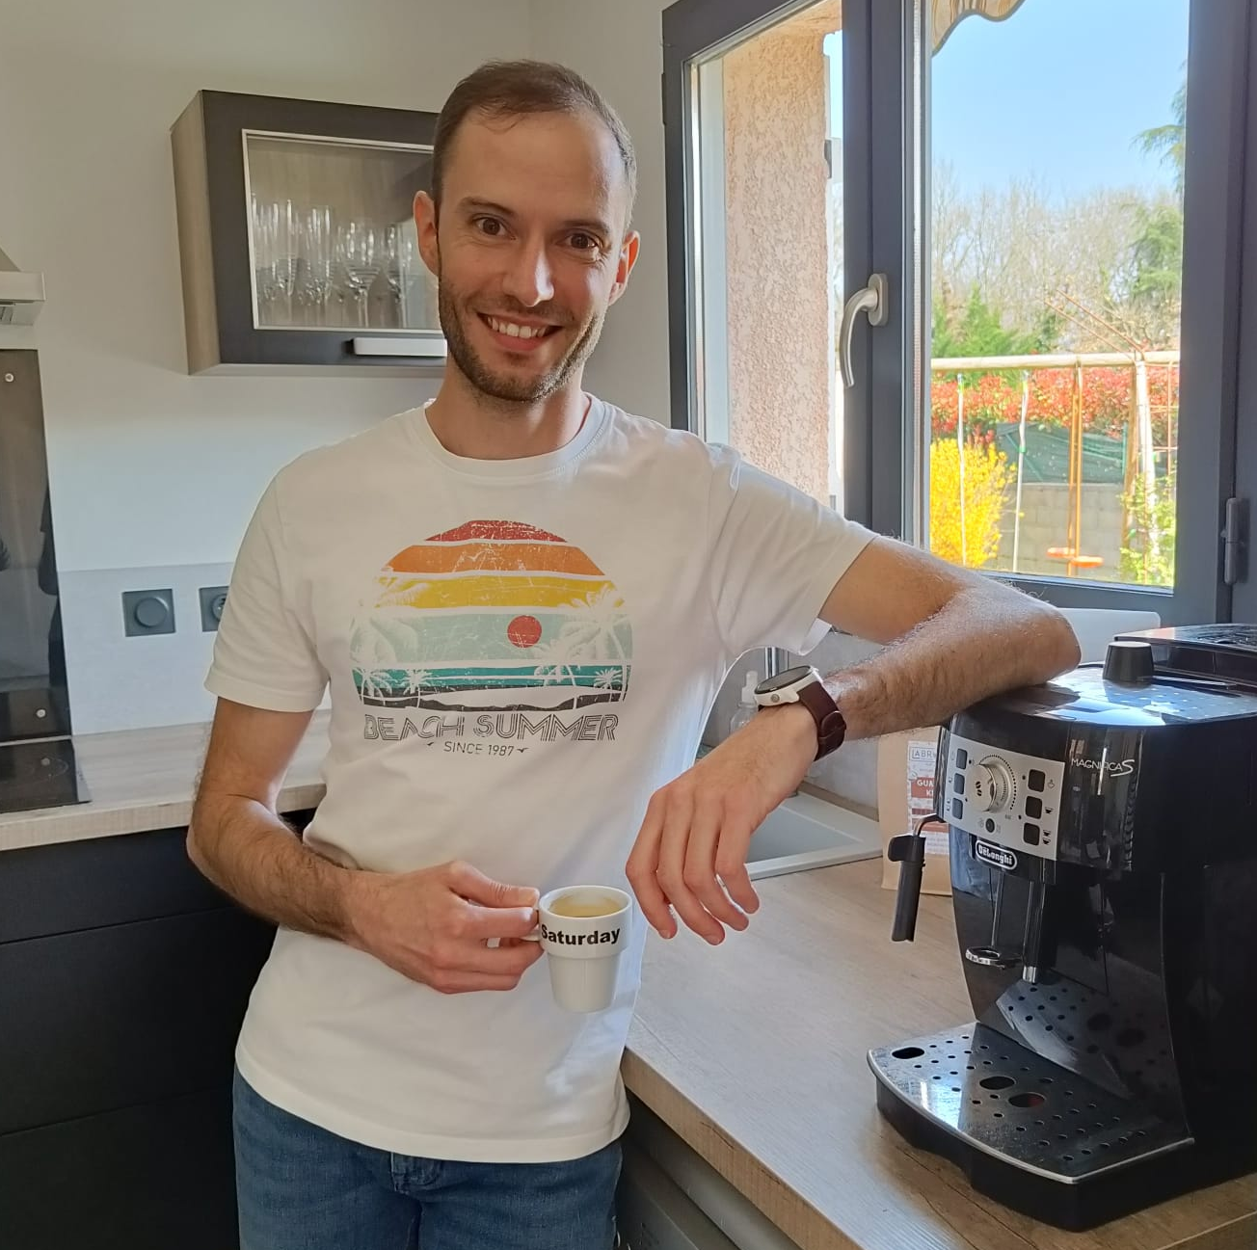
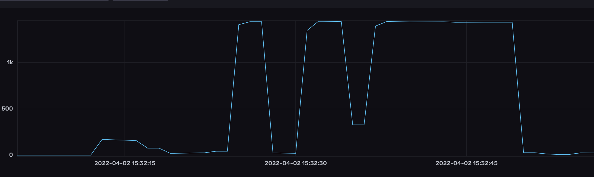
My coffee machine ❤
Theoretical input power
1450 W
Shelly flashed it at 1444 W
Rescuing penguins with Rust – Julien Faixo

Slide 8
The measuring setup
Telegraf
Retrieve system metrics
Send to InfluxDB
InfluxDB
Store metrics
Allow to query
Data visualization
Eth
Raspberry Pi 4
Router
Gigabit ethernet
Wifi
Eth
Telegraf
Retrieve Shelly metric
Send to InfluxDB
Wifi
Shelly
Measure power consumption
PC
Rescuing penguins with Rust – Julien Faixo

Slide 9
The measuring setup
Telegraf
Retrieve system metrics
Send to InfluxDB
InfluxDB
Store metrics
Allow to query
Data visualization
Send
Raspberry Pi 4
Router
Gigabit ethernet
Wifi
Send
Measure
Telegraf
Retrieve Shelly metric
Send to InfluxDB
Shelly
Measure power consumption
Fetch
PC
Rescuing penguins with Rust – Julien Faixo

Slide 10

Let’s make some measures !
Rescuing penguins with Rust – Julien Faixo

Slide 11
Some takeaways about power consumption
CPU: Depends on load of each core
Idle ~> Halt until next interrupt
DVFS: Dynamic Voltage and Frequency Scaling
RAM: State does not affect consumption
Memory cells keep skrinking, so do their input voltage
DRAM Memory refresh have a huge impact ^{[1]}
[1] What Every Programmer Should Know About Memory
Rescuing penguins with Rust – Julien Faixo

Slide 12
Some takeaways about power consumption
CPU: Depends on load of each core
Idle ~> Halt until next interrupt
DVFS: Dynamic Voltage and Frequency Scaling
RAM: State does not affect consumption
Memory cells keep skrinking, so do their input voltage
DRAM Memory refresh have a huge impact ^{[1]}
Network: Constant consumption, no matter the load
Reducing your bandwidth consumption will have 0 effect on the network infrastructure power consumption ^{[2]}
[1] What Every Programmer Should Know About Memory [2] Mesurer le CO2 selon les gigaoctets consommés : l’idée qui consterne le secteur du numérique
Rescuing penguins with Rust – Julien Faixo

Slide 13

Let’s talk about technology footprints

Slide 14
The dumb test
GET /?name=world
Response: Hello world
Implemented with
Node + Express
Node + Express clustered
Node + Fastify
Node + Fastify clustered
Java + Vert.x (with Kotlin)
Rust + Actix
Rescuing penguins with Rust – Julien Faixo

Slide 15
Let’s make some measures !
Rescuing penguins with Rust – Julien Faixo

Slide 16
Results
Rescuing penguins with Rust – Julien Faixo

Slide 17
Results
Rescuing penguins with Rust – Julien Faixo

Slide 18
Results
Rescuing penguins with Rust – Julien Faixo

Slide 19
Some takeaways about technologies
Performance varies significantly across technologies
In order to reach the same operational requirements, hardware requirements may be significantly higher
More hardware to build
More power consumption
In a cloud context, you pay what you use
Efforts regarding performance will probably result in cost reduction
Rescuing penguins with Rust – Julien Faixo

Slide 20
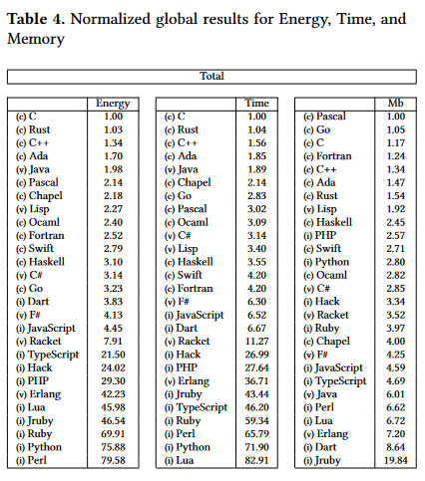
Energy Efficiency across Programming Languages
27 languages
10 benchmarking problems
Energy, execution time and peak memory consumption measures
Source: Energy Efficiency across Programming Languages
Rescuing penguins with Rust – Julien Faixo

Slide 21


What can we do for the penguins ?

Slide 22
Environmental Impact of Digital Technology in France
All criteria included : End user devices have the biggest impacts (63,6% to 92%) , followed by data centers, and networks
Fabrication/distribution/usage & eol: Fabrication have the biggest impact
Regarding usage, impacts mainly come from power consumption
Source: Evaluation de l’impact environnemental du numérique en France et analyse prospective, Arcep
Rescuing penguins with Rust – Julien Faixo
Notes:
Un premier niveau d’analyse montre que les terminaux « utilisateur » sont responsables de la majorité des impacts pour chaque indicateur (entre 63,6% et 92% des impacts), suivi par les centres de données et les réseaux (respectivement entre 4% et 22,3%, et entre 2% et 14 %). Un second niveau de distribution d’impact est présenté selon les phases du cycle de vie (fabrication, distribution, utilisation et fin de vie). Ces résultats montrent que la phase de fabrication est la principale source d’impact pour les trois tiers, suivi de la phase d’utilisation ce qui confirme l’importance des politiques visant à allonger la durée d’usage des équipements numériques à travers la durabilité des produits, le réemploi, le reconditionnement, l’économie de la fonctionnalité ou la reparation
Concernant l’utilisation, les impacts viennent majoritairement de la consommation d’électricité.

Slide 23
Some challenges
Limit the renewal of equipment as much as possible
Frontend: Prioritize User Experience
Backend: Design for performance
Increase computational density
Optimize resources usage
Minimize resources consumption of jobs
Rescuing penguins with Rust – Julien Faixo

Slide 24


Rust to the rescue !

Slide 25
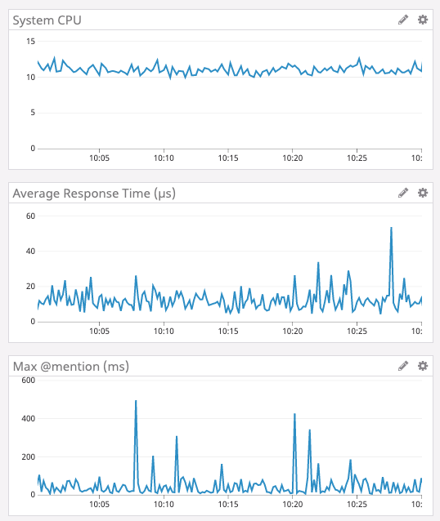
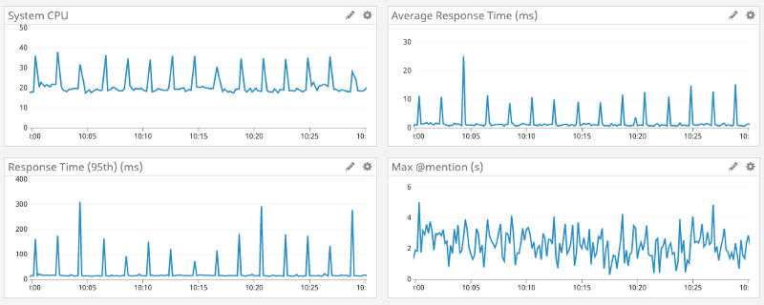
Some optimization stories
Discord
Had latency spike issues due to Go Garbage Collector
Go
Rust
Source : https://discord.com/blog/why-discord-is-switching-from-go-to-rust
Rescuing penguins with Rust – Julien Faixo

Slide 26
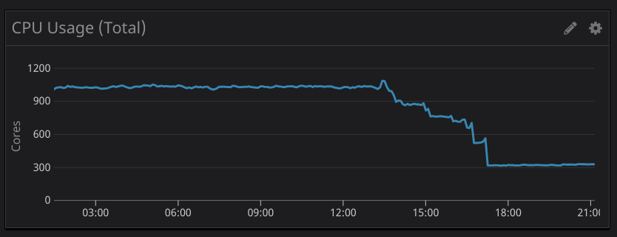
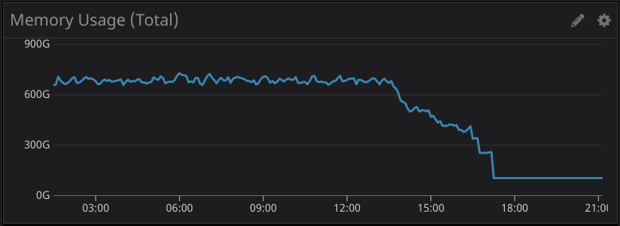
Some optimization stories
Tenable.io
Use a custom metrics filter in their datadog sidecar agent, originally written in Node. They had scalability issues with this filter, consuming more and more compute resource as their platform scale up.
Tenable rewrote it in Rust :
75% reduction in CPU
95% reduction in memory usage
50% faster
Raw save of 700 CPU and 300GB
Source : https://medium.com/tenable-techblog/optimizing-700-cpus-away-with-rust-dc7a000dbdb2
Rescuing penguins with Rust – Julien Faixo

Slide 27

Rust is hard to master… but to me, it’s worth it
Rust is harder to learn because you have to understand what you do
But in the end, you have :
A deeper understanding and control of your software ^{[1]}
Uncompromising performance
Reliability : Memory safety, thread safety, a demanding compiler
Productivity : Modern language, a “friendly” compiler
Rust brings answers to two of the challenges of the decade : sustainable IT, and cybersecurity
[1] If you want to go really deep: https://fasterthanli.me/
Rescuing penguins with Rust – Julien Faixo
Notes:
Entre 60% et 80% des vulnérabilités sont dues a des problèmes de memory safety

Slide 28

Thanks for them !

